Slide 1

Effective resource management with AWS Config
November 2023

Slide 2
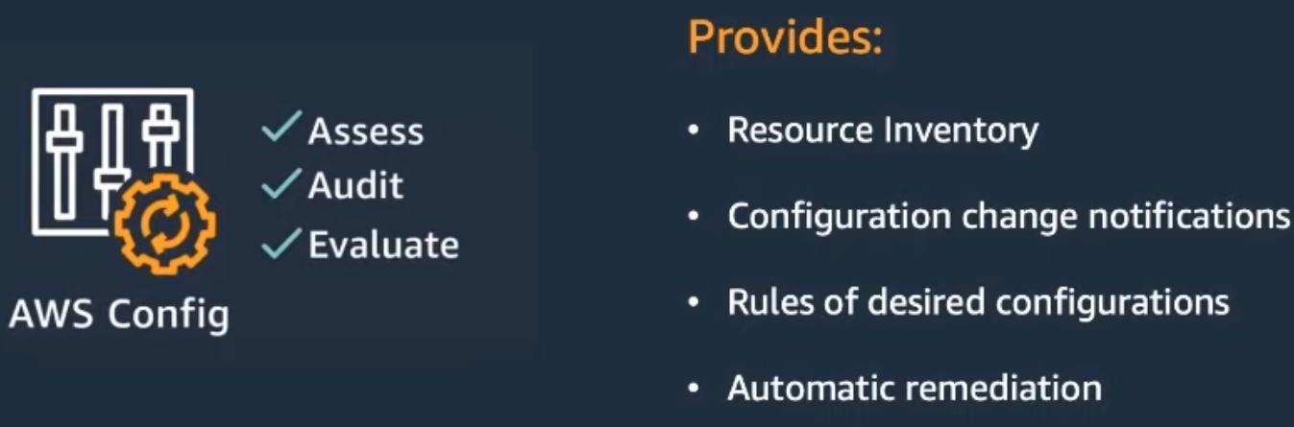
What is AWS Config?
Notes:
AWS Config provides an easy way to Assess, Audit, and Evaluate the configuration of the resources in your account to maintain security, compliance, and governance
AWS Config provides a Resource Inventory of resources in your account where you can apply rules, receive notifications, and provide remediation policies when resources deviate from a compliance state

Slide 3
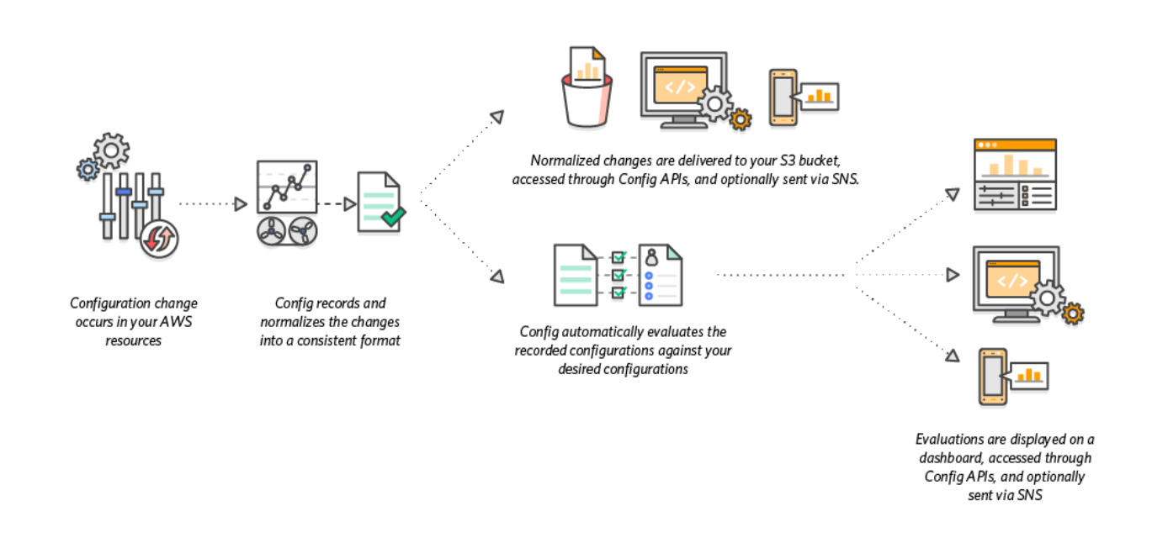
How AWS Config works
Notes:
AWS Config discovers supported resources through the Describe and List API calls
A configuration item is created and Configuration Recorder maintains historical records in S3 whenever the configuration of a resource changes
If AWS Config Rules are configured, the recorded configuration is evaluated against the desired configuration to determine whether a resource is COMPLIANT or NON COMPLIANT
Remediation actions can be taken on Non Compliant resources to get them back to a compliant state
Conformance Packs can also be used to simplify deployment of multiple rules and remediation across Accounts and Regions

Slide 4
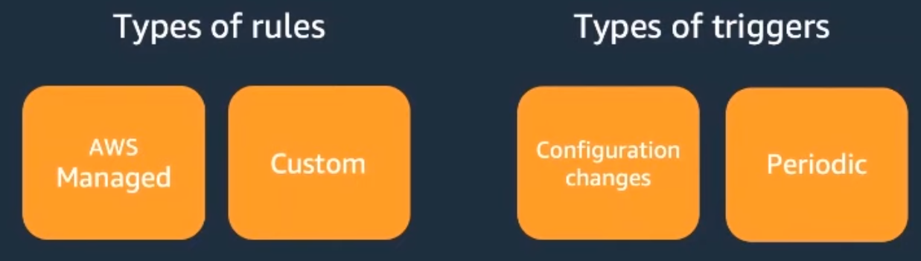
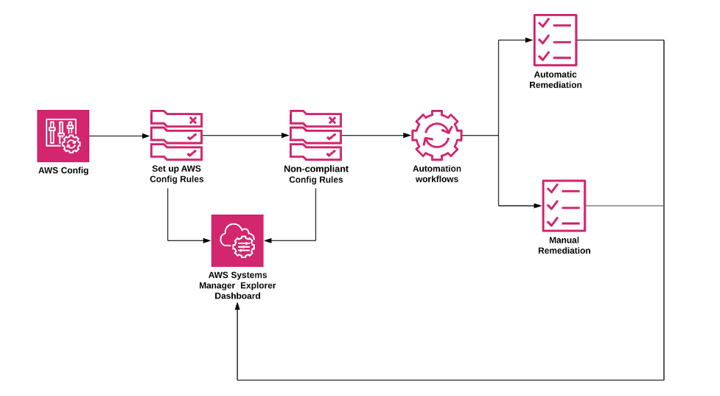
AWS Config Rules and Remediation
Notes:
Resource configuration is evaluated with AWS Config rules
These rules can either be
Managed Rules, which are pre-defined and customizable rules created by AWS
Custom Rules, which are customer authored rules backed by Lambda or Guard
There are two triggers in which rules are evaluated
With Configuration Changes, the rule is evaluated whenever the configuration of a resource changes
The Periodic trigger allows evaluation at a set frequency, for example, every 24 hours
>Remediation of noncompliant resources can be applied through Systems Manager Automation documents
Systems Manager provides a set of managed automation documents or you may create your custom Systems Manager Automation documents

Slide 5

Problem
Lambda Hyperplane ENIs are created for each Security Group and Subnet combination
We make the most efficient use of our ENI quota by sharing the same Security Group and Subnet combination
Notes:
AWS Config can be configured to ensure we maintain the optimal network configuration of our Lambda functions to limit our ENI usage
We can setup an AWS Config Custom Rule to evaluate the network configuration of our Lambda functions

Slide 6











aws-config-lambda-shared-eni
Change Configuration Item
AWS Lambda
API
Rule
AWS CloudTrail
Events
AWS Config
Console
COMPLIANT
NON COMPLIANT
Amazon EventBridge
Amazon SNS
Notes:
> When a Lambda function changes either from the API or in the Console an event is logged in CloudTrail Events
> Configuration Recorder creates a configuration item and the associated AWS Config Custom Rule is evaluated
> This rule evaluates whether the configuration item has the correct Security Group and Subnet combination
> A resulting PutEvaluation API call is made to update the configuration status with AWS Config
> Upon receipt, AWS Config updates the configuration status of the configuration item as either COMPLIANT or NON COMPLIANT
> Because AWS Config already publishes events to EventBridge, an email subscription to a SNS Topic can notify of any detected non compliant configurations

Slide 7
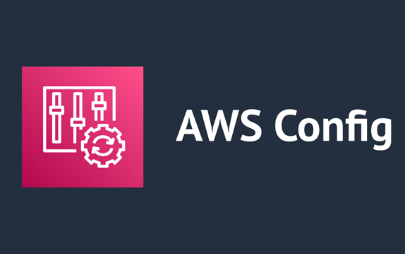
🔌Demo Time 🔨
Uncover the truth

Slide 8
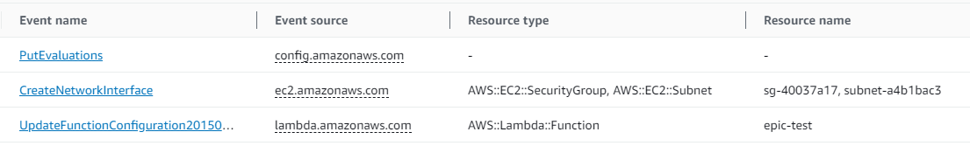
1. CloudTrail Events
Notes:
Here we see the `epic-test` Lambda function is updated (the bottom event)
A Subnet is removed from the VPC configuration of the Lambda function, shown in the middle event
The top event shows AWS Config performed a PutEvaluations API call to update the configuration status of the configuration item

Slide 9
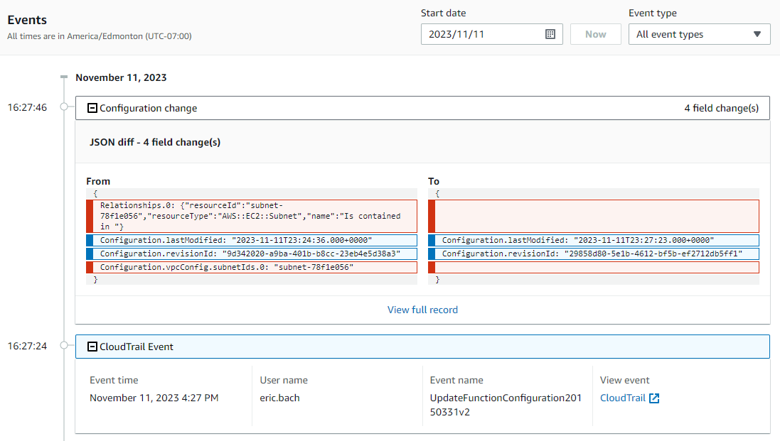
2. Resource Timeline
Notes:
The Resource Timeline of the configuration item shows the CloudTrail Event as well as the recorded configuration change to the network configuration

Slide 10
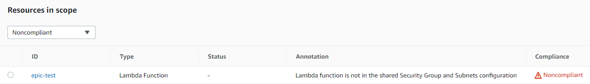
3. Compliant Status
Notes:
When we check the resource, `epic-test`, in AWS Config we see the function is now marked as Noncompliant with the custom Annotation we specified in our AWS Config Custom Rule

Slide 11
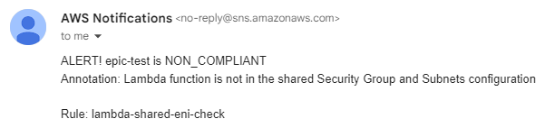
4. Notification
Notes:
This also sends a message to the SNS Topic with an email subscription to notify us of the mis-configuration

Slide 12
Thanks!
Feedback/Questions?
👍

